Slide 1

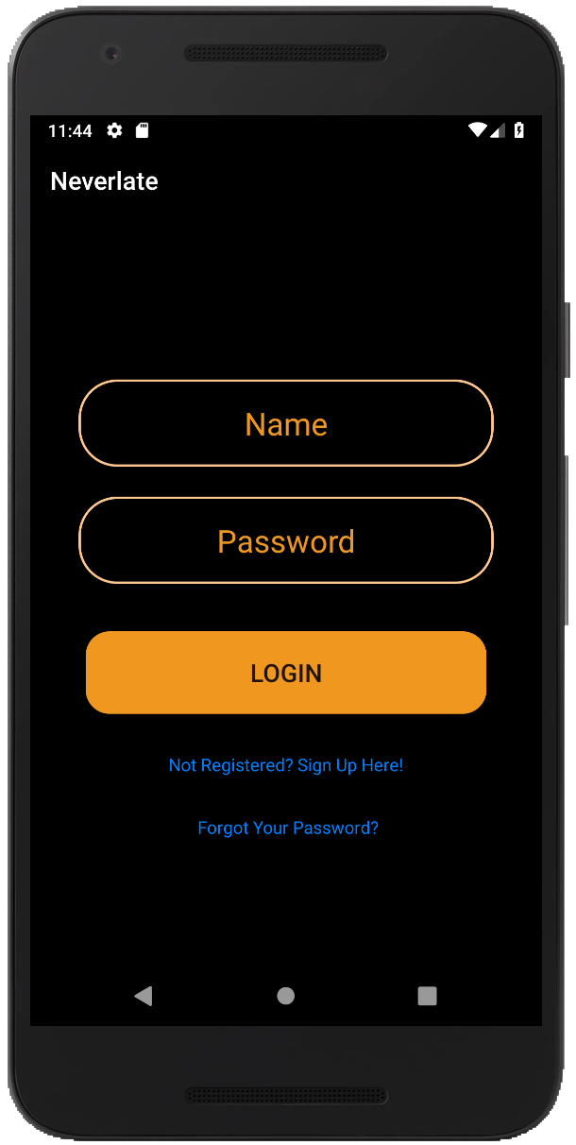
Never Late

Slide 2
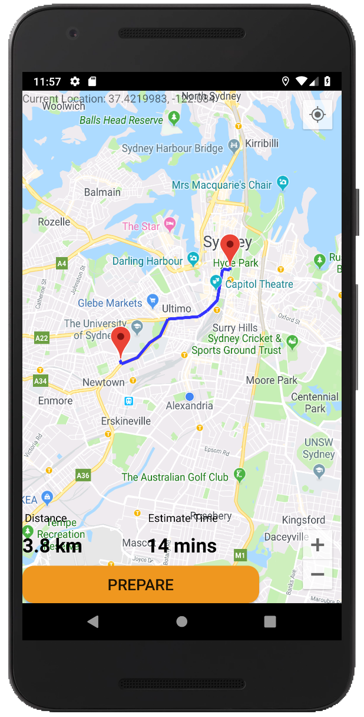
Target users: People who drive to work
Based on your departure location and destination, you will be given a best routes recommended by Never Late.
Aim to help users arrive the destination on time via change the users’ time alarm according to traffic situations.
Estimate time cost will be calculated via the measured distance and provided speed.

Slide 3
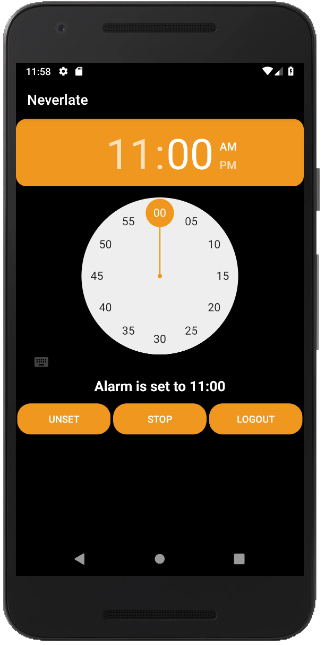
The estimate time cost will be given back to the alarm and the users’ arrive alarm will be automatically reset forward.
Keep Calm
and
Never Late!

Slide 4
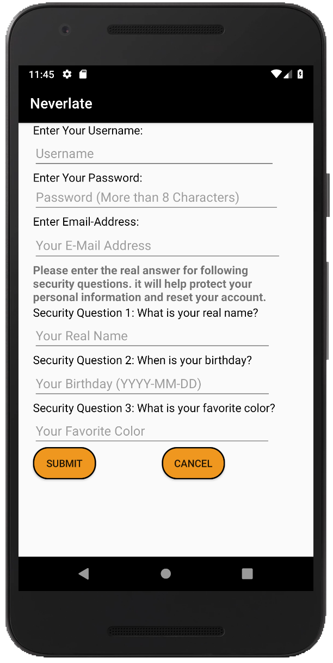
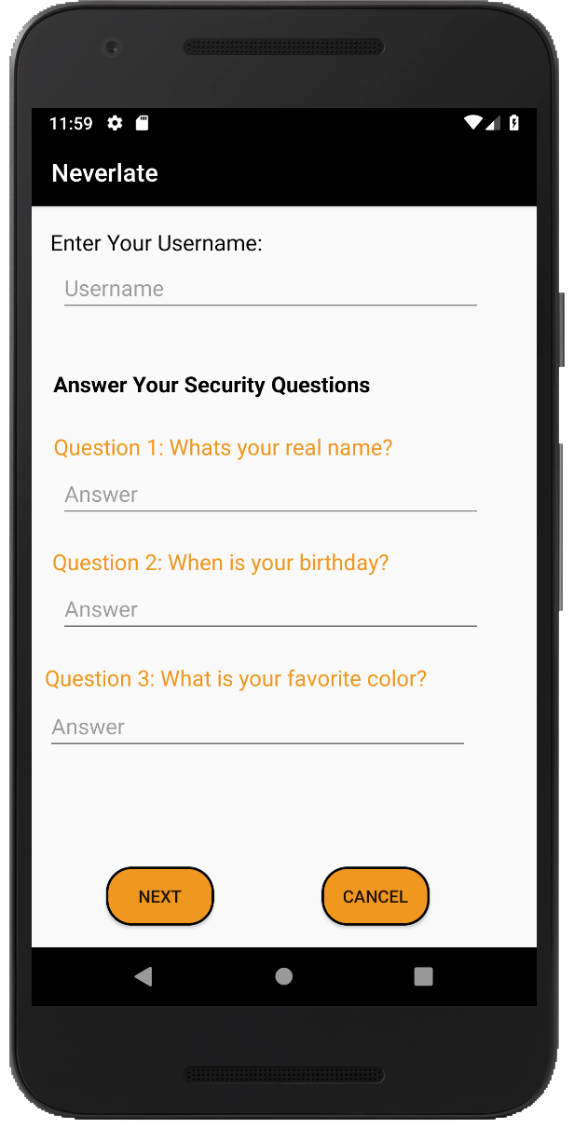
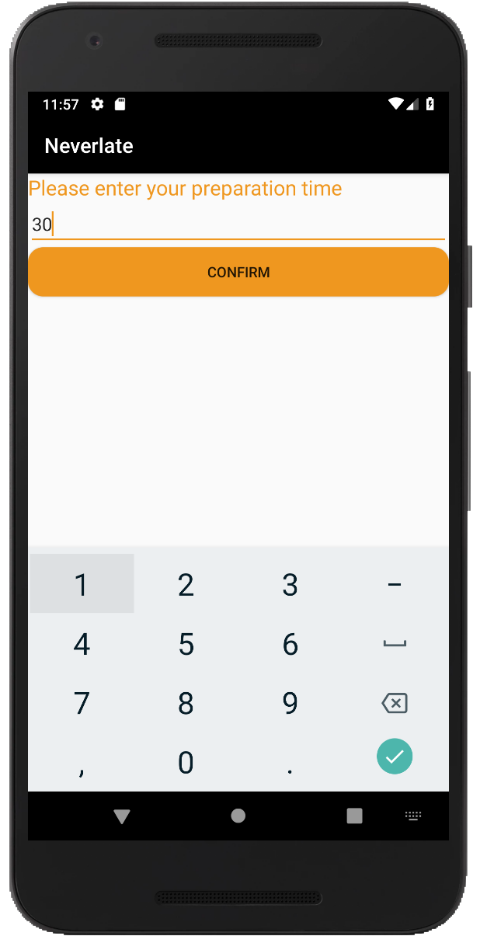
Simple Instructions
Click sign up to register and input necessary information
Click forget password to reset the password
Login
Click to input prepare time and confirm
Confirm the prepare time and set the arrive time, the alarm will be set and ring at the calculated time.
Click sign out to log out and return back to Login page
Choose the destination

Slide 5
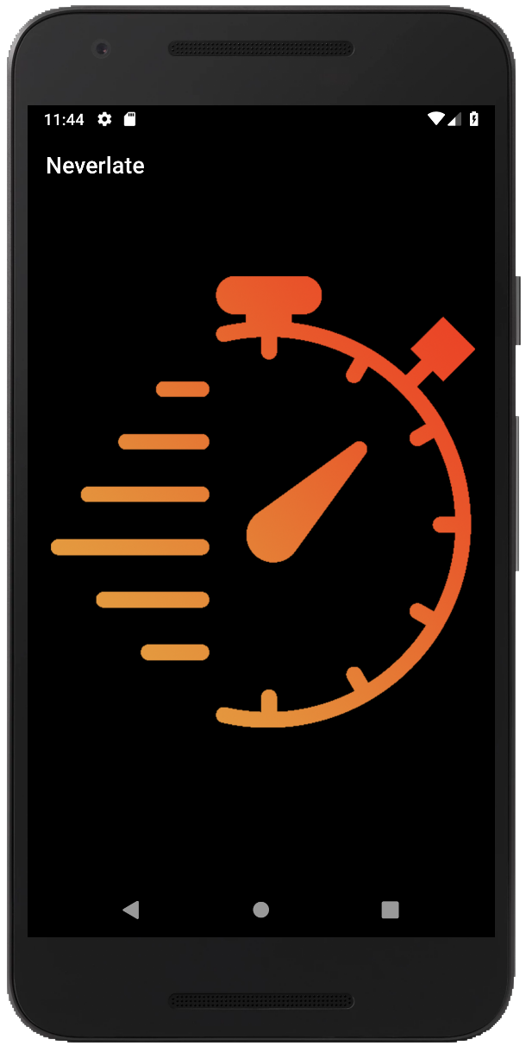

High Customization
Creative
UI Friendly
Convenient
Intuitive
Expansibility
High Integrality

Slide 6
New definition for the “alarm”: Users will get the “time to go” alarm accordingly to their set arrive time.
Our app will set the smart alarm after taking possible influence elements (traffic）into consideration.
Sustainable Innovation

Slide 7
Thank You!

